Slide 1
API-driven Cloud Native Solutions
Notes:
Hello everyone!

Slide 2
CC ZG506
Lectures No. 5 and No. 6

Slide 3
Evaluation
Evaluation Component | Name | Type | Weight | Duration
EC – 1 | Quiz I | Online | 5%
 | Assignment I | Online | 15%
 | Assignment II | Online | 15%
EC – 2 | Mid-term Exam | Closed book | 30% | 2 hours
EC – 3 | End Semester Exam | Open book | 35% | 2.5 hours
Quiz 1: 7-Sep-24 till 10-Sep 24
Assignment 1: 05-Sep-24 till 15-Oct-24

Slide 4
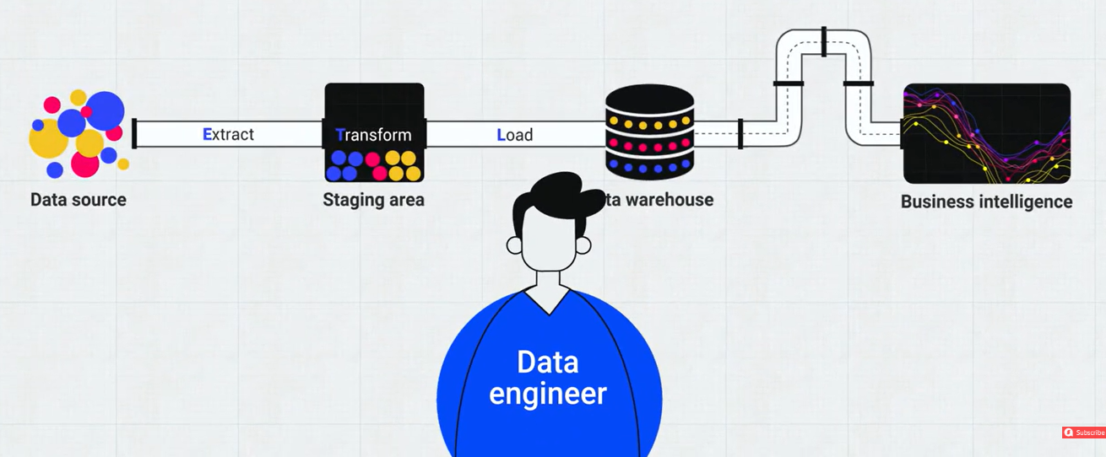
Recap
Notes:
The Recap slide summarizes the data engineering pipeline and highlights the role of a Data Engineer in transforming raw data into actionable business intelligence.
Key Steps in the Data Pipeline:
Data Source:
Origin of raw data, which could include databases, APIs, or other data streams.
Extract:
Data is extracted from the source in its raw format.
Tools commonly used: Apache Nifi, Talend, or custom ETL scripts.
Transform:
Data undergoes cleaning, normalization, and format conversion in the staging area.
Transformations ensure the data is ready for analysis.
Tools: Apache Spark, AWS Glue, or SQL-based transformations.
Load:
Transformed data is loaded into a Data Warehouse or Data Lake for long-term storage and retrieval.
Popular platforms: Snowflake, Amazon Redshift, Google BigQuery.
Business Intelligence:
Processed data is visualized and used to derive insights.
Tools: Tableau, Power BI, or Looker.
Role of the Data Engineer:
Ensures seamless data flow through the pipeline.
Manages:
Data quality and consistency during transformation.
System optimization for scalable data processing.
Integration with Business Intelligence tools for final insights.

Slide 5
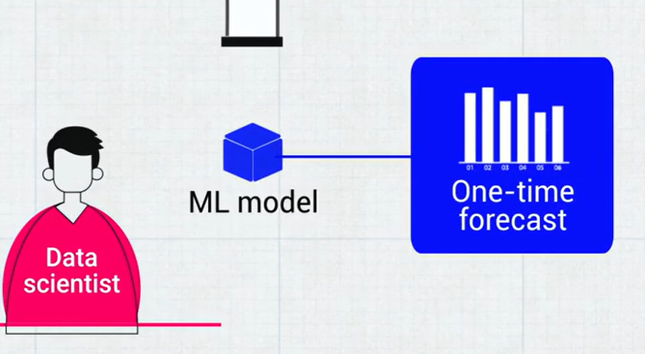
Recap
Notes:
This Recap slide highlights the role of a Data Scientist in leveraging Machine Learning (ML) models to generate actionable outcomes, such as one-time forecasts.
Key Components:
Data Scientist:
Responsible for designing and implementing ML models.
Works on tasks like data preprocessing, feature engineering, model training, and evaluation.
ML Model:
Core analytical tool built using algorithms like Random Forest, Neural Networks, SVM, etc.
Trained on historical data to identify patterns and make predictions.
One-time Forecast:
Output of the ML model, such as a prediction or recommendation.
Could represent insights like sales forecasts, patient outcomes, or resource allocation.
This slide emphasizes a streamlined process where:
Data Engineers prepare and deliver the data.
Data Scientists focus on predictive analysis and delivering results to stakeholders.

Slide 6
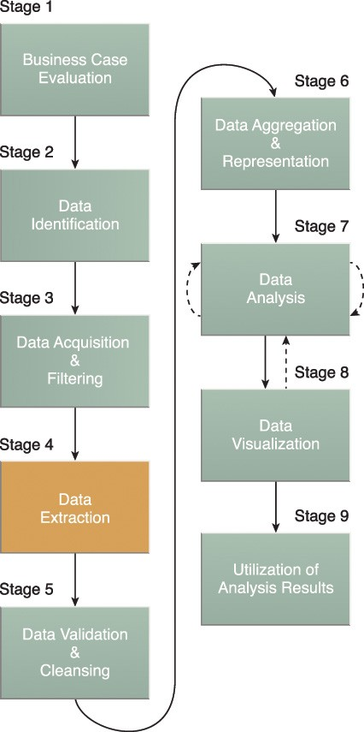
Big Data Analytics Life Cycle
(Recap)
Notes:
This slide provides a Recap of the Big Data Analytics Life Cycle, summarizing the structured approach to handling data in large-scale projects.
Stages Breakdown:
Business Case Evaluation:
Identify the objectives and scope of the project, focusing on key stakeholders' needs.
Data Identification:
Locate and determine the sources of data required for analysis.
Data Acquisition & Filtering:
Collect raw data from identified sources and apply initial filtering to remove irrelevant or duplicate entries.
Data Extraction:
Extract specific data points or features relevant to the problem being addressed.
Data Validation & Cleansing:
Ensure data quality by handling missing values, correcting inaccuracies, and normalizing formats.
Data Aggregation & Representation:
Combine data from various sources and represent it in a structured format suitable for analysis.
Data Analysis:
Conduct exploratory and statistical analysis, and apply machine learning models to derive insights.
Data Visualization:
Create visual representations like charts and dashboards to communicate findings effectively.
Utilization of Analysis Results:
Apply insights to decision-making processes, operational improvements, or strategic planning.
Key Insights:
The process flows logically, but it also includes iterative feedback loops, especially between analysis and data preparation stages.
Emphasis is placed on ensuring data integrity before analysis to derive meaningful and actionable insights.
Visualization is critical for stakeholder understanding and buy-in.

Slide 7
Agenda
DataOps
Building a Cloud-native Data Pipeline and accessing the application using APIs
Notes:
This slide presents the Agenda of the discussion or presentation, focusing on two key aspects:
DataOps:
Exploring the principles, practices, and applications of DataOps in data management and analytics.
Understanding its role in improving data pipeline efficiency, automation, and collaboration within organizations.
Building a Cloud-Native Data Pipeline and Accessing the Application Using APIs:
Discussing the architecture and design of a scalable and efficient cloud-native data pipeline.
Leveraging APIs to interact with and integrate applications, enabling seamless data ingestion, processing, and delivery.

Slide 8
DataOps

Slide 9
Need for DataOps
Can DevOps principles directly be applied to Data Science processes?
What are the hindrances?
Can data and code be treated the same way? For example, in DevOps, a working code is delivered to end-users at the end of CI/CD. Will a refined, pre-processed data be available for analysis to the Data Analysts or Data Scientists in the same agile way?
Notes:
This slide addresses the Need for DataOps and poses critical questions about its application and challenges in the context of data science processes:
Key Points:
Can DevOps principles directly be applied to Data Science processes?
Highlights the possibility of leveraging DevOps methodologies like Continuous Integration/Continuous Delivery (CI/CD), automation, and version control for data science workflows.
What are the hindrances?
Suggests exploring challenges such as the variability of data, lack of standardization, data volume, and the complexity of integrating diverse datasets.
Can data and code be treated the same way?
For example, in DevOps, CI/CD ensures that code is delivered seamlessly to end-users. The slide questions whether pre-processed, refined data can be made available for data analysts and scientists with the same agility and consistency.
Reflection:
While code is deterministic, data is often non-deterministic, with variability in format, structure, and quality. Hence, adapting DevOps directly to data science might require adjustments.
DataOps bridges this gap by introducing pipelines, automation, and monitoring to treat data as a product.

Slide 10
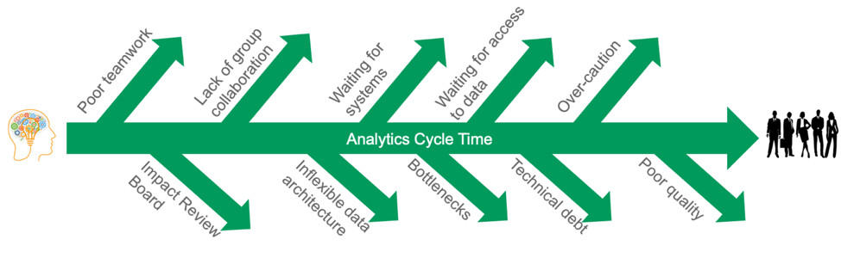
Data Teams’ Challenges
Data teams are constantly interrupted by data errors
https://datakitchen.io/what-is-dataops/
Notes:
This slide outlines Data Teams' Challenges in the context of analytics and DataOps. It emphasizes how data errors and inefficiencies disrupt analytics cycles, leading to delays and reduced productivity.
Key Challenges:
Poor Teamwork:
Lack of synergy within data teams affects progress.
Lack of Group Collaboration:
Disconnection between team members causes misaligned objectives.
Waiting for Systems:
System availability delays crucial processes.
Waiting for Access to Data:
Data accessibility issues halt progress.
Impact Review Board:
Extensive approval processes slow down data pipelines.
Inflexible Data Architecture:
Rigid architectures are not conducive to agile modifications.
Bottlenecks:
Resource constraints or system lags affect analytics timelines.
Over-Caution:
Excessive caution results in delays, often in regulatory or sensitive environments.
Technical Debt:
Outdated or inefficient systems and codebases burden teams.
Poor Quality Data:
Low-quality data undermines analytics outcomes and model performance.
Central Issue:
These challenges collectively elongate the Analytics Cycle Time, making it hard to deliver insights efficiently.

Slide 11
Data Challenges
Adoption of DevOps to Data Science discipline is slow and gradual
Data Science, and Data Exploration in particular are more exploratory process, compared to software development.
Bottlenecks
  Data Gathering (more sources added or removed constantly)
  Data Cleansing
  Data Exploration (Univariate, Bivariate and Multivariate analysis)
  Data Pipeline environments more difficult to reproduce compared to software application environments
Notes:
This slide identifies key Data Challenges in adopting DevOps principles to Data Science. It highlights how the exploratory nature of Data Science and its processes make integration with DevOps slower and more gradual.
Key Challenges:
Slow Adoption of DevOps in Data Science:
Unlike software development, Data Science relies on dynamic and iterative exploration, making it harder to implement structured DevOps principles.
Exploratory Nature of Data Science:
Data Science often requires flexibility to test hypotheses and explore new insights, which contrasts with the structured and automated workflows in DevOps.
Bottlenecks:
Data Gathering:
Continuous addition/removal of sources complicates the process.
Data Cleansing:
Time-consuming processes to ensure data quality for meaningful analysis.
Data Exploration:
Univariate, bivariate, and multivariate analyses are resource-intensive and not easily standardized.
Data Pipeline Challenges:
Data pipeline environments are more complex and harder to reproduce compared to software application environments.
Key Insight:
The challenges stem from the inherent differences between the disciplines—Data Science being exploratory and DevOps focusing on automation and continuous integration. Overcoming these requires tools and methodologies tailored to the nuances of Data Science.

Slide 12
DataOps
It is a way to streamline, manage, and automate data flow within an Organization.
Implementing DevOps strategies
Includes Data Ingestion, transformation, processing, analysis
Reduces time and resources required to manage the infrastructure
Notes:
This slide introduces DataOps, a methodology designed to streamline, manage, and automate the flow of data within an organization.
Key Highlights:
Purpose:
Streamlines and automates the data flow processes.
Ensures efficient data management for organizations.
Key Components:
Implementing DevOps strategies: Adapting principles from DevOps to enhance data-related workflows.
Data pipeline operations: Focuses on tasks like Data Ingestion, Transformation, Processing, and Analysis.
Benefits:
Reduces the time and resources required to manage and maintain data infrastructure.
Enhances productivity by automating repetitive tasks and minimizing manual interventions.
Relevance:
DataOps serves as the backbone for organizations looking to integrate agile practices into data management. It ensures real-time access to clean, processed, and usable data for decision-making and analytical tasks.

Slide 13
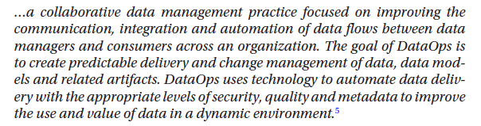
DataOps definition
Gartner Definition..
Notes:
The slide provides Gartner's definition of DataOps, focusing on its purpose and goals.
Key Points from Gartner's Definition:
Objective:
Improve communication, integration, and automation of data flows.
Facilitate collaboration between data managers and consumers across the organization.
Goal:
Create predictable delivery and effective change management of:
Data.
Data models.
Related artifacts.
Ensure seamless and reliable data delivery.
Technology in DataOps:
Automates data delivery while maintaining appropriate levels of:
Security.
Quality.
Metadata management.
Impact:
Enhances the use and value of data in dynamic and fast-changing environments.
Importance:
This definition underscores DataOps as a discipline aimed at bridging the gap between data engineering, data science, and business needs. By automating workflows and improving collaboration, DataOps ensures data is a strategic asset for organizations.

Slide 14
DataOps definition
DataKitchen’s Definition
DataOps = Agile Practices + Lean Thinking + Data Analytics + DevOps
Agile Practices ensure that we work on the “right things” that add value for the “right people”
Lean Thinking focuses on eliminating waste and bottlenecks, improving quality, monitoring data flows, and making data cheaper for consumers
DevOps practices build a culture of collaboration between historically siloed teams.
Data Analytics - Descriptive, Diagnostic, Predictive and Prescriptive.
Brings together self-contained teams having Data Analytics, Data Scientists, Data Engineers, Machine Learning Engineers and DevOps Engineers.
Notes:
The slide presents DataKitchen's Definition of DataOps, emphasizing its multidisciplinary approach to enhance data processes and outcomes.
Key Components of DataOps (DataKitchen Definition):
Agile Practices:
Focus on working on the "right things" that deliver value to the appropriate stakeholders.
Enable adaptability and quick iteration in response to changing requirements.
Lean Thinking:
Aims to minimize waste and bottlenecks.
Improves quality and efficiency in data workflows.
Makes data more affordable and accessible for end-users.
DevOps Practices:
Encourages collaboration and communication between historically siloed teams.
Utilizes principles such as CI/CD (Continuous Integration/Continuous Delivery) for data processes.
Data Analytics:
Covers various analytics types:
Descriptive: What happened?
Diagnostic: Why did it happen?
Predictive: What will happen?
Prescriptive: What should be done?
Aids decision-making by providing actionable insights.
Team Collaboration:
Brings together diverse roles:
Data Analysts.
Data Scientists.
Data Engineers.
Machine Learning Engineers.
DevOps Engineers.
Promotes a holistic approach to handling data challenges.
Summary:
DataOps combines agile methodologies, lean processes, collaborative DevOps culture, and comprehensive analytics to create seamless, efficient, and value-driven data workflows. This approach ensures that organizations can derive maximum utility and insights from their data assets.

Slide 15
DataOps
DevOps concepts used in DataOps
Source Code Management (Git)
Continuous Integration (CI)
Continuous Delivery / Deployment (CD)
Operations : Monitoring and Logging [Observability]
Culture: Collaboration and Communication
Notes:
This slide highlights DevOps concepts utilized in DataOps, illustrating the intersection between these two methodologies for managing efficient data pipelines and workflows.
Key DevOps Concepts Applied in DataOps:
Source Code Management (Git):
Version control for data workflows and scripts.
Enables tracking changes and collaborative development of data pipelines.
Continuous Integration (CI):
Automates testing of data pipeline components (e.g., ETL scripts, models).
Ensures new updates integrate seamlessly without breaking existing functionality.
Continuous Delivery/Deployment (CD):
Deploys updated models, workflows, and dashboards in production environments.
Reduces manual intervention and ensures rapid iterations.
Operations: Monitoring and Logging (Observability):
Tracks data pipeline performance and identifies anomalies.
Logs provide insights into errors or issues for quicker resolutions.
Culture: Collaboration and Communication:
Encourages interaction between Data Engineers, Scientists, and Analysts.
Promotes a shared understanding of objectives and smooth coordination across teams.
Why These Concepts Matter:
By leveraging DevOps principles, DataOps ensures smoother, automated workflows, rapid iterations, and a collaborative culture that minimizes bottlenecks in data operations.

Slide 16
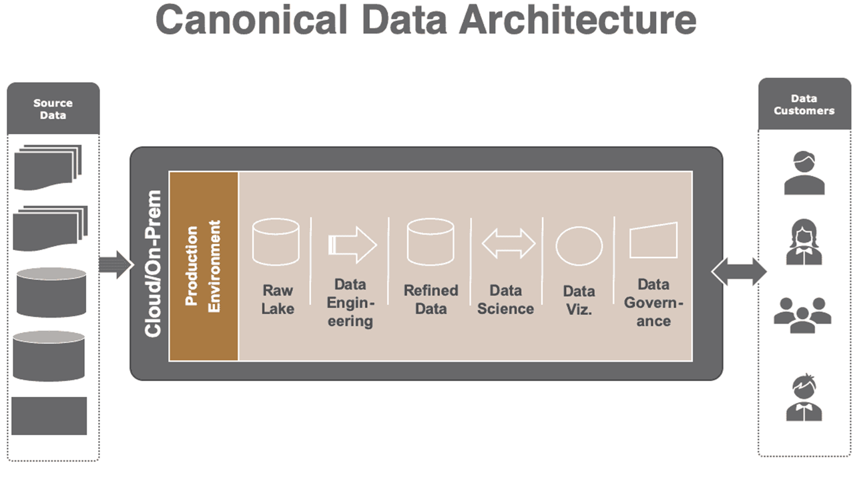
Canonical Data Architecture
https://datakitchen.io/dataops-data-architecture/
Notes:
This slide illustrates a Canonical Data Architecture model, which serves as a blueprint for managing data efficiently across its lifecycle, from ingestion to delivery. Here's a breakdown of the components:
Key Components:
Source Data:
Raw data coming from diverse sources (e.g., transactional databases, IoT devices, APIs).
The first step in the pipeline.
Production Environment (Cloud/On-Prem):
Provides the infrastructure for hosting and processing data.
Can be either cloud-based or on-premises depending on organizational needs.
Raw Lake:
A centralized repository where unprocessed data is stored.
Acts as the foundation for further data engineering processes.
Data Engineering:
Processes raw data by cleaning, transforming, and structuring it for analysis.
Includes tasks like ETL (Extract, Transform, Load) and feature engineering.
Refined Data:
Structured, processed data ready for use in advanced analytics or reporting.
Ensures data consistency and usability.
Data Science:
Advanced analytics and machine learning are applied here.
Involves predictive modeling, clustering, and other ML techniques.
Data Visualization (Data Viz):
Translates processed data into visual formats (charts, dashboards) for easier interpretation.
Used for deriving actionable insights.
Data Governance:
Ensures compliance, data quality, and security.
Handles metadata management, auditing, and access controls.
Data Customers:
End-users who consume the insights and processed data.
Includes business analysts, data scientists, decision-makers, and external clients.
Purpose:
This architecture enables streamlined data workflows and ensures that each stage of the data lifecycle is accounted for, making it possible to derive valuable insights efficiently while maintaining quality and governance.

Slide 17
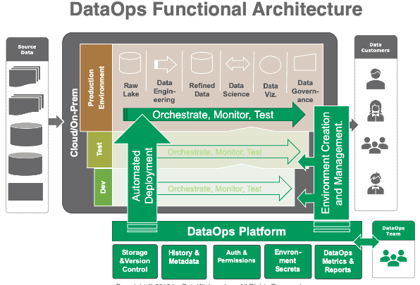
DataOps Functional Architecture
Notes:
This slide represents the DataOps Functional Architecture, which is designed to enable efficient and automated data workflows while maintaining quality, collaboration, and governance across data teams. Here's an explanation of its key elements:
Core Components:
Data Sources:
Represents the raw data inputs from various sources.
Includes transactional systems, IoT devices, APIs, etc.
Cloud/On-Prem Environment:
Contains multiple stages such as:
Raw Lake: Repository for unprocessed data.
Data Engineering: ETL processes and transformations.
Refined Data: Cleaned and structured data for analytics.
Data Science: Advanced analytics and machine learning processes.
Data Visualization (Viz): Generating insights and dashboards.
Data Governance: Ensuring security, compliance, and metadata management.
Development, Test, and Production Environments:
These stages ensure that changes and updates are validated in a controlled manner before reaching production.
Automation supports consistent deployment across all environments.
Automated Deployment:
Automates the movement of data pipelines, models, and analytics across environments (Dev → Test → Prod).
Ensures faster delivery and fewer errors.
Orchestrate, Monitor, and Test:
Orchestration tools manage workflows and data pipelines.
Monitoring ensures the health and performance of pipelines.
Testing validates data quality and integrity across all stages.
Environment Creation and Management:
Automates the creation and management of data environments.
Enables consistent configurations across teams and projects.
DataOps Platform:
Provides essential functionalities:
Storage & Version Control: Tracks changes in data and pipelines.
History & Metadata: Maintains data lineage and metadata.
Authentication & Permissions: Manages secure access to resources.
Environment Secrets: Handles sensitive information securely.
Metrics & Reports: Monitors performance and generates reports.
Data Customers:
Stakeholders such as analysts, data scientists, and business users who consume the data outputs.
DataOps Team:
A dedicated team responsible for implementing and managing DataOps practices, ensuring smooth operations and collaboration.
Objective:
The architecture aligns with DataOps principles, promoting agility, collaboration, and efficiency in handling data workflows. It focuses on reducing cycle times, automating repetitive tasks, and ensuring high data quality.

Slide 18
DataOps Automation
Orchestrates, tests, and monitors the data pipeline.
Automate the process
Data flows in from hundreds or thousands of sources and is integrated, cleaned, processed, and published for analytics.
Check data for anomalies
For data errors, notify test results
Dashboard – View metrics based on monitoring
Notes:
This slide on DataOps Automation outlines key processes for orchestrating, automating, and monitoring data pipelines. Here's a breakdown of its components:
Key Elements:
Orchestration, Testing, and Monitoring:
Ensures that data pipelines run smoothly.
Automates task execution and schedules processes across stages.
Tests the integrity and accuracy of data during its flow.
Monitors pipelines for performance and anomalies.
Automation of Processes:
Data Ingestion:
Seamlessly integrates data from multiple sources (hundreds or thousands) into the system.
Data Transformation:
Cleans and processes raw data into formats suitable for analytics.
Data Publication:
Makes processed data available for analytics and decision-making.
Anomaly Detection:
Automatically scans incoming and processed data for inconsistencies or irregularities.
Ensures data quality by flagging issues in real-time.
Error Notifications:
Alerts teams when errors or discrepancies occur during processing.
Provides test results to assist in debugging and error resolution.
Dashboards for Metrics:
Visual interfaces for tracking pipeline performance and health.
Offers key metrics for monitoring data flow efficiency and error rates.
Objective:
The goal of DataOps Automation is to create a reliable, self-sustaining data ecosystem that minimizes manual intervention, ensures consistent data quality, and provides real-time insights into pipeline operations.

Slide 19
DataOps Tools
Open Source options
Apache AirFlow [Workflow automation tool]
Prefect [Workflow automation tool] and Prefect Cloud
DagSter [ETL pipelines and ML pipelines]
Curated list of DataOps tools - https://github.com/kelvins/awesome-dataops
Commercial options
DataKitchen [DataOps tool]
Unravel [Data Observability tool]
Notes:
Open Source Options:
Apache AirFlow:
A popular workflow automation tool.
Allows for scheduling and monitoring workflows.
Especially useful in orchestrating complex data pipelines.
Prefect:
Another workflow automation tool.
Features Prefect Cloud for managing workflows with added monitoring and analytics.
Focuses on simplicity and ease of deployment compared to Apache AirFlow.
Dagster:
Designed for ETL (Extract, Transform, Load) and ML pipelines.
Provides strong typing and dependency management for data pipelines.
Offers real-time monitoring and debugging capabilities.
Curated list of DataOps tools:
A GitHub repository with a comprehensive list of tools for various DataOps functionalities.
Link: https://github.com/kelvins/awesome-dataops.
Commercial Options:
DataKitchen:
A robust DataOps platform.
Offers tools for orchestration, monitoring, and pipeline automation.
Facilitates collaboration between data engineers, scientists, and analysts.
Unravel:
Focused on data observability and pipeline performance optimization.
Offers insights into the efficiency of data flows and analytics.
Applications:
These tools aim to:
Automate data workflows.
Improve collaboration across teams.
Monitor and enhance data quality.
Streamline data operations for better business intelligence and machine learning outcomes.

Slide 20
Building a Cloud-native
Data Pipeline and Accessing using APIs
Notes:
The slide appears to introduce the topic of Building a Cloud-Native Data Pipeline and Accessing Using APIs. Here’s an interpretation of the subject:
Key Concepts:
Cloud-Native Data Pipeline:
A cloud-native data pipeline is designed to run in cloud environments using cloud resources. It leverages cloud-native services for storage, processing, and orchestration.
It is scalable, resilient, and optimized for performance in distributed systems.
Building Components:
Data Ingestion: Pulling data from multiple sources (databases, APIs, streams).
Data Transformation: Applying ETL (Extract, Transform, Load) processes for data cleaning and formatting.
Storage: Using cloud storage solutions like AWS S3, Google Cloud Storage, or Azure Blob Storage for raw and processed data.
Processing Engines: Employing tools like Apache Spark, Apache Beam, or AWS Glue for large-scale data processing.
API-Based Access:
APIs (Application Programming Interfaces) enable developers and applications to interact with the data pipeline.
They provide real-time access to data and insights, making it easy to integrate pipeline outputs with applications or analytics tools.
Advantages of Cloud-Native Pipelines:
Scalability: Easily handles increasing data loads by utilizing the elasticity of the cloud.
Cost Efficiency: Pay-as-you-go models reduce costs for small or infrequent workloads.
Automation: Pipelines can be automated using tools like Apache Airflow or Prefect.
Integration: APIs allow seamless integration with dashboards, machine learning models, or other business systems.

Slide 21
Prefect - Data Orchestration Tool
Workflow orchestration tool for data scientists and ML engineers
Only knowledge of Python is required, easy to learn
Open source (Commercial) version of Prefect Cloud
REST API access for data management
URL - https://www.prefect.io/
Notes:
The slide describes Prefect as a Data Orchestration Tool used for automating and managing data workflows effectively. Here's a summary of the key points:
Prefect - Data Orchestration Tool
Purpose:
Designed for data scientists and machine learning engineers to manage workflows efficiently.
Ideal for orchestrating complex data pipelines with dependencies.
Ease of Use:
Requires basic Python knowledge.
Simple and intuitive, making it easy to learn and implement.
Versions Available:
Open Source: Free to use for on-premise or private setups.
Prefect Cloud: A commercial version with added features and cloud-native capabilities.
Features:
Supports REST API for seamless data management and integration with external systems.
Provides workflow visualization, logging, and monitoring tools.
Applications:
Automates ETL (Extract, Transform, Load) processes.
Orchestrates tasks in machine learning pipelines.
Integrates easily with cloud-native services.
URL for More Details:
Official website: Prefect.io

Slide 22
Prefect
Pre-requisites
pip install -U prefect
2a. Run Prefect on the Cloud [Hosted on AWS]
prefect cloud login [Log in with a browser]
OR
2b. Run prefect locally -> prefect server start
URL - https://docs.prefect.io/latest/tutorial/
Notes:
The slide outlines the pre-requisites for setting up and running Prefect, a workflow orchestration tool:
Prefect Setup
Pre-requisites:
Install Prefect:
Use the following command to install or update Prefect:
Copy code
pip install -U prefect
Run Prefect:
Option A: Run Prefect on the Cloud (Hosted on AWS)
Authenticate by logging in:
Copy code
prefect cloud login
Open a browser for login.
Option B: Run Prefect Locally
Start the local Prefect server:sql
Copy code
prefect server start
Resources:
Refer to the official tutorial for detailed guidance: Prefect Documentation
Code –
Setting Up a Prefect Workflow
Here’s a breakdown of running a workflow in Prefect, both locally and using Prefect Cloud:
Local Workflow Setup
Step 1: Install Prefect
Ensure you have Python installed. Run:
bash
Copy code
pip install -U prefect
Step 2: Create a Workflow
Here’s a simple Python script to define a workflow:
python
Copy code
from prefect import task, Flow # Define tasks @task def extract(): return [1, 2, 3] @task def transform(data): return [x * 10 for x in data] @task def load(data): print(f"Loaded data: {data}") # Define the workflow with Flow("ETL Workflow") as flow: data = extract() transformed_data = transform(data) load(transformed_data) # Save this as etl_flow.py
Step 3: Run Locally
Start a Prefect server locally:
bash
Copy code
prefect server start
Run the flow script:
bash
Copy code
python etl_flow.py
If using Prefect’s local backend, the script will execute directly.
Using Prefect Cloud
Step 1: Login to Prefect Cloud
Log in to Prefect Cloud using:
bash
Copy code
prefect cloud login
Open your browser, authenticate, and follow the prompts.
Step 2: Register Workflow with Cloud
Update the script to use the Prefect Cloud API:
python
Copy code
from prefect import task, Flow from prefect.run_configs import DockerRun from prefect.storage import Docker @task def extract(): return [1, 2, 3] @task def transform(data): return [x * 10 for x in data] @task def load(data): print(f"Loaded data: {data}") with Flow("ETL Workflow") as flow: data = extract() transformed_data = transform(data) load(transformed_data) # Define cloud configuration flow.storage = Docker("my-docker-image") flow.run_config = DockerRun(image="my-docker-image") # Register the workflow with Prefect Cloud flow.register(project_name="My Project")
Step 3: Run Workflow in Prefect Cloud
After registration, the workflow will appear in the Prefect Cloud UI. Use the UI or CLI to trigger execution:
bash
Copy code
prefect run flow --name "ETL Workflow"
Key Differences
Local: Quick setup for small-scale workflows. Data and workflows are stored locally.
Cloud: Best for collaboration, tracking, and scaling workflows. Requires Docker for cloud execution.

Slide 23
Prefect Architecture
Account ID
Workspace ID
Prefect API Key
PREFECT CLOUD
Workspace
Schedule or trigger
Deployment
Flow
Run(s)
Python Functions with annotators @flow or @task
Task(s)
Notes:
The Prefect Architecture depicted in this image highlights the following key components and workflow in Prefect Cloud:
Key Components
Workspace
Acts as the central hub in Prefect Cloud, organizing flows and deployments.
Requires configuration using:
Account ID
Workspace ID
Prefect API Key
Deployment
Represents a versioned instance of a workflow that can be scheduled or triggered.
Contains metadata about the flow and its execution environment.
Flow
Defines the overall workflow logic composed of multiple tasks.
It is triggered via deployments in the Prefect Cloud workspace.
Task(s)
The smallest unit of work within a flow, defined using Python functions with decorators like @task or @flow.
Run(s)
Execution instances of the flow.
Can be scheduled or triggered manually, with real-time monitoring of results in Prefect Cloud.
Workflow Overview
Define Python Functions:
Use @task to define individual tasks.
Use @flow to define the flow logic combining multiple tasks.
Create Deployment:
Register the flow with Prefect Cloud as a deployment using Prefect CLI or Python API.
Trigger or Schedule Execution:
Deployments can be scheduled to run periodically or triggered on-demand via the Prefect Cloud interface or API.
Monitor Runs:
Use Prefect Cloud's dashboard to view real-time logs, status, and metrics of the flow runs.
Summary
This architecture ensures streamlined orchestration of data workflows while enabling cloud-based monitoring, scheduling, and scalability. It is suitable for complex workflows requiring collaboration and robust observability.

Slide 24
Data Science Project
Steps:
Data Ingestion [get data from data source]
Data Pre-processing or Cleaning
Data Exploration – EDA (Exploratory Data Analysis]
Data Analysis [ML code]
Data Visualization
One Deployment
One Main Flow
Tasks for each activity
Scheduled runs
Notes:
This slide outlines the steps involved in orchestrating a Data Science Project using Prefect's workflow orchestration capabilities. Here's how these steps align with Prefect's architecture:
Steps in the Data Science Workflow
Data Ingestion
Collecting data from various sources (e.g., APIs, databases, or flat files).
This would be represented as a Task in the Prefect flow.
Data Pre-Processing or Cleaning
Removing inconsistencies, filling missing values, and ensuring the data is ready for analysis.
Another Task focused on ETL (Extract, Transform, Load) operations.
Data Exploration - EDA (Exploratory Data Analysis)
Performing statistical summaries and visualizations to understand the data.
Tasks in this phase involve data inspection and feature engineering.
Data Analysis
Running Machine Learning (ML) algorithms or statistical models.
Tasks here include training models, performing predictions, and evaluating metrics.
Data Visualization
Generating charts or dashboards to present the results.
Visualization tasks would output graphs or send results to business intelligence tools.
Alignment with Prefect Concepts
One Deployment:
The entire data science workflow is encapsulated into a single deployment in Prefect Cloud.
One Main Flow:
The steps listed above (1 to 5) form the Flow, defining the end-to-end logic of the project.
Tasks for Each Activity:
Each step (e.g., ingestion, preprocessing, analysis) is defined as an individual Task within the flow.
Tasks can run independently but contribute to the overall workflow.
Scheduled Runs:
Once deployed, the flow can be set to execute on a predefined schedule, ensuring periodic or event-driven runs.
Benefits
Using Prefect for this workflow brings:
Automation and orchestration across all steps.
Scalability and fault tolerance with retries for failing tasks.
Centralized monitoring via Prefect Cloud's UI.

Slide 25
Demo

Slide 26
Prefect Demo I
Minimal Example
Steps:
Import required library -> “Pima-Indian Diabetes dataset” [Classification]
Data Pre-processing
Model Training using Logistic Regression Model
Define the Prefect Flow and all the related tasks
Calculate the Accuracy and display in the “Prefect Cloud – Dashboard”
Notes:
This slide outlines a minimal example of using Prefect to orchestrate a machine learning pipeline on the Pima-Indian Diabetes Dataset. Here's a step-by-step breakdown with integration into Prefect:
Steps for Prefect Demo
Import Required Libraries
Use libraries like Pandas, Scikit-learn, and Prefect.
Load the Pima-Indian Diabetes dataset.
Data Pre-processing
Perform steps like handling missing values, encoding categorical features, and splitting data into training and testing sets.
Create a Prefect Task for pre-processing.
Model Training
Train a Logistic Regression model on the pre-processed dataset.
Define this as another Task.
Define the Prefect Flow
Combine the tasks (data ingestion, pre-processing, model training) into a Flow.
Use decorators like @task for functions and @flow for the overall orchestration.
Calculate Accuracy and Display in Prefect Dashboard
Compute the model's accuracy using the test dataset.
Log metrics and visualize them on Prefect Cloud Dashboard.
Prefect Implementation Example
Here’s how the implementation might look in Python:
python
Copy code
from prefect import task, flow import pandas as pd from sklearn.model_selection import train_test_split from sklearn.linear_model import LogisticRegression from sklearn.metrics import accuracy_score @task def load_data(): url = "https://raw.githubusercontent.com/jbrownlee/Datasets/master/pima-indians-diabetes.data.csv" column_names = ['Pregnancies', 'Glucose', 'BloodPressure', 'SkinThickness', 'Insulin', 'BMI', 'DiabetesPedigreeFunction', 'Age', 'Outcome'] data = pd.read_csv(url, names=column_names) return data @task def preprocess_data(data): X = data.drop("Outcome", axis=1) y = data["Outcome"] X_train, X_test, y_train, y_test = train_test_split(X, y, test_size=0.2, random_state=42) return X_train, X_test, y_train, y_test @task def train_model(X_train, y_train): model = LogisticRegression(max_iter=1000) model.fit(X_train, y_train) return model @task def evaluate_model(model, X_test, y_test): predictions = model.predict(X_test) accuracy = accuracy_score(y_test, predictions) return accuracy @flow def ml_pipeline(): data = load_data() X_train, X_test, y_train, y_test = preprocess_data(data) model = train_model(X_train, y_train) accuracy = evaluate_model(model, X_test, y_test) print(f"Model Accuracy: {accuracy}") # Run the Prefect Flow if __name__ == "__main__": ml_pipeline()
Output on Prefect Cloud
The Prefect Cloud Dashboard will:
Show the success/failure of each task (e.g., data loading, pre-processing).
Log metrics such as the model accuracy.
Provide visual monitoring and debugging capabilities.

Slide 27
Data Science Project
Covid Patient Discharge Prediction
(Dataset: 2nd Wave April-2021 to June 2021)
Type of Project: Data Science and Machine Learning
Dataset size: 1233 patients suffering from Covid
Variables:
X: Age, Gender, Co_morbid, Admit Date, Discharge date, days of stay, covid_severity
Y: Discharge Type (Recovered, Expired)
Exploratory Data Analysis: Univariate, Bivariate, Multivariate
Models applied: Support Vector Machine, Naïve Bayes, Logistic Regression, Decision Trees, KNN, ANN, Random Forest
Best Accuracy: Random Forest (92%)
Notes:
This slide provides a detailed overview of a Covid Patient Discharge Prediction project using data from the 2nd wave of the pandemic. Below is an expanded explanation and approach to implementing the project:
Project Details
Type of Project: Data Science and Machine Learning
Dataset Size: 1233 patients
Objective: Predict whether a patient will recover or expire upon discharge based on demographic and clinical data.
Dataset Overview
Input Features (X):
Demographic Variables: Age, Gender
Clinical Variables: Co-morbidities, Admission Date, Discharge Date, Days of Stay, Covid Severity
Target Variable (Y):
Discharge Type: Recovered or Expired
Exploratory Data Analysis (EDA)
Univariate Analysis: Distribution of variables like Age, Days of Stay, and Covid Severity.
Bivariate Analysis: Relationship between features and target variable (e.g., Covid Severity vs. Discharge Type).
Multivariate Analysis: Combined analysis of multiple features to identify patterns.
Modeling Approach
Algorithms Applied:
Support Vector Machine (SVM)
Naive Bayes
Logistic Regression
Decision Trees
K-Nearest Neighbors (KNN)
Artificial Neural Network (ANN)
Random Forest
Best Model:
Random Forest achieved the highest accuracy: 92%
Steps to Implement
1. Data Pre-processing
Handle missing values.
Convert categorical features (e.g., Gender, Co-morbidity) to numerical using encoding techniques.
Normalize continuous variables (e.g., Days of Stay, Age).
2. Feature Engineering
Derive additional features (e.g., Duration of Stay = Discharge Date - Admit Date).
One-hot encode Covid Severity categories.
3. Model Training
Split the dataset into training and testing sets (e.g., 80:20 split).
Train and evaluate multiple machine learning models.
Use Random Forest for its robustness and ensemble capabilities.
4. Evaluation Metrics
Accuracy: Measure overall performance.
Precision, Recall, F1-score: Focus on the "Expired" class to handle class imbalance (if present).
Python Code Example
Below is a simplified implementation:
python
Copy code
import pandas as pd from sklearn.model_selection import train_test_split from sklearn.ensemble import RandomForestClassifier from sklearn.metrics import accuracy_score, classification_report # Load Dataset data = pd.read_csv("covid_patient_data.csv") # Replace with actual path # Pre-processing data['Gender'] = data['Gender'].map({'Male': 0, 'Female': 1}) data['Days_of_Stay'] = (pd.to_datetime(data['Discharge_Date']) - pd.to_datetime(data['Admit_Date'])).dt.days X = data[['Age', 'Gender', 'Co_morbid', 'Days_of_Stay', 'Covid_Severity']] y = data['Discharge_Type'].map({'Recovered': 0, 'Expired': 1}) # Train-Test Split X_train, X_test, y_train, y_test = train_test_split(X, y, test_size=0.2, random_state=42) # Model Training model = RandomForestClassifier(random_state=42) model.fit(X_train, y_train) # Predictions y_pred = model.predict(X_test) # Evaluation print(f"Accuracy: {accuracy_score(y_test, y_pred)}") print(classification_report(y_test, y_pred))
Potential Enhancements
Hyperparameter Tuning: Use GridSearchCV or RandomizedSearchCV to optimize Random Forest.
Explainability: Use SHAP or LIME to explain feature importance.
Deploying the Model: Use Prefect or similar tools for workflow orchestration and deploying predictions to a dashboard.

Slide 28
Covid Dataset Overview
Gender: Categorical (M/F)
Age: Numeric
Co_Morbid: Binary (1 = Yes, 0 = No)
Admit_date & Discharge_date: Dates
Remdesivir_Given: Binary (1 = Given, 0 = Not Given)
DaysOfStay: Numeric
DischargeType: Numeric (1-Recovered; 2-Expired)
Covid_Severity: Numeric (1 = Mild, 2 = Moderate, 3 = Severe)
Covid_SeverityDescription: Categorical (Mild, Moderate, Severe)
DischargeTypeCategorical: Categorical (Recovered, Expired)
Notes:
This slide provides a clear overview of the Covid Dataset. Below is a breakdown of the dataset's features and a step-by-step approach to handling the data for machine learning purposes.
Feature Details
Gender:
Type: Categorical
Values: M (Male) / F (Female)
Encoding Suggestion: Convert to binary (e.g., 0 for Male, 1 for Female).
Age:
Type: Numeric
Values: Continuous.
Co_Morbid:
Type: Binary
Values: 1 = Yes, 0 = No.
Admit_date & Discharge_date:
Type: Date
Usage: Calculate DaysOfStay (e.g., Discharge_date - Admit_date).
Remdesivir_Given:
Type: Binary
Values: 1 = Given, 0 = Not Given.
DaysOfStay:
Type: Numeric
Derived from Discharge_date - Admit_date.
DischargeType:
Type: Numeric
Values: 1 = Recovered, 2 = Expired.
Covid_Severity:
Type: Numeric
Values:
1 = Mild
2 = Moderate
3 = Severe.
Covid_SeverityDescription:
Type: Categorical
Values: Mild, Moderate, Severe.
Encoding Suggestion: Map to numeric levels (1, 2, 3).
DischargeTypeCategorical:
Type: Categorical
Values: Recovered, Expired.
Encoding Suggestion: Map to binary or keep as a categorical label.
Data Preprocessing Steps
Handling Missing Values:
Check for missing or null values and impute or drop if necessary.
Example: For numeric features, use mean/median imputation; for categorical, use the mode.
Feature Encoding:
Convert Gender, Covid_SeverityDescription, and DischargeTypeCategorical into numeric values.
Use one-hot encoding for categorical variables if necessary.
Feature Engineering:
Create DaysOfStay from Admit_date and Discharge_date.
Combine or transform features if correlations exist (e.g., Age and Covid_Severity).
Normalization:
Scale numeric features like Age, DaysOfStay, and Covid_Severity using Min-Max Scaling or Standardization.
Splitting Data:
Split the dataset into training and testing sets (e.g., 80:20 split).
Exploratory Data Analysis (EDA)
Univariate Analysis:
Check distribution of Age, DaysOfStay, and Covid_Severity.
Bivariate Analysis:
Explore relationships between features and DischargeType (e.g., Co_Morbid vs. DischargeType).
Correlation Matrix:
Identify multicollinearity between features.
Machine Learning Pipeline
Model Selection:
Train multiple models: Logistic Regression, Random Forest, SVM, etc.
Evaluate models using accuracy, precision, recall, and F1-score.
Hyperparameter Tuning:
Optimize models (e.g., n_estimators in Random Forest).
Cross-Validation:
Use k-fold cross-validation to generalize results.
Evaluation:
Generate a confusion matrix to measure true positives and false positives.
Compare model performance metrics.
Python Code Snippet for Preprocessing
python
Copy code
import pandas as pd from sklearn.preprocessing import LabelEncoder, StandardScaler # Load Dataset data = pd.read_csv("covid_data.csv") # Feature Engineering data['DaysOfStay'] = (pd.to_datetime(data['Discharge_date']) - pd.to_datetime(data['Admit_date'])).dt.days # Encode Categorical Variables data['Gender'] = data['Gender'].map({'M': 0, 'F': 1}) data['Covid_SeverityDescription'] = data['Covid_SeverityDescription'].map({'Mild': 1, 'Moderate': 2, 'Severe': 3}) data['DischargeTypeCategorical'] = data['DischargeTypeCategorical'].map({'Recovered': 0, 'Expired': 1}) # Select Features and Target X = data[['Age', 'Gender', 'Co_Morbid', 'DaysOfStay', 'Covid_Severity', 'Remdesivir_Given']] y = data['DischargeType'] # Normalize Features scaler = StandardScaler() X_scaled = scaler.fit_transform(X)
Next Steps
Implement the pipeline and evaluate the performance.
Deploy the model using a DataOps tool like Prefect for automated workflows.

Slide 29
Prefect Demo II
Full Workflow demonstration for a Data Science Project
Executing the Project from VS Code terminal and running on Prefect Cloud.
Objectives: Observe the deployment, runs, flows and tasks in the Prefect Cloud Dashboard
https://github.com/shreyassureshrao/dsp.git
Notes:
The slide highlights a Prefect Demo II, which showcases a full workflow demonstration for a Data Science project. Below are the detailed steps and objectives:
Objective
Demonstrate the complete process of a Data Science project by:
Executing the project from the VS Code terminal.
Running and monitoring the workflow on Prefect Cloud.
Observe the following on the Prefect Cloud Dashboard:
Deployments: How the workflow is deployed.
Runs: Individual instances of the workflow execution.
Flows: The structured tasks in the workflow.
Tasks: The breakdown of specific operations within the flow.
Key Elements
Environment Setup:
Install and configure Prefect Cloud and Prefect CLI on your local machine.
Connect your project (hosted in the VS Code terminal) to Prefect Cloud using your account and API credentials.
Workflow Implementation:
Define your data science workflow using Prefect's @flow and @task decorators in Python.
Example: Data ingestion, preprocessing, model training, evaluation, and deployment as individual tasks.
Execution:
Trigger the deployment from the VS Code terminal using Prefect CLI commands, e.g.,:bash
Copy code
prefect deployment create my_flow.py prefect deployment run my_flow/2024-11-25-10:30
Monitor the flow, its tasks, and the run's progress on the Prefect Cloud Dashboard.
Observation on Dashboard:
Deployments: View the workflow version and scheduling details.
Runs: See logs, runtime status, and task completion.
Tasks: Verify if specific operations (e.g., preprocessing or model training) execute successfully.
Project Repository
The project is available at:
GitHub Link: https://github.com/shreyassureshrao/dsp.git
Next Steps
Clone the repository to your local system:
bash
Copy code
git clone https://github.com/shreyassureshrao/dsp.git cd dsp
Follow the Prefect setup instructions provided in the project documentation.
Execute and monitor the workflow in Prefect Cloud.

Slide 30
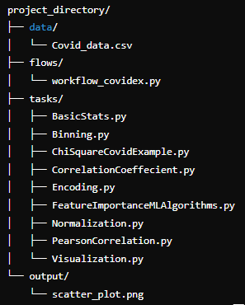
Folder Structure
Notes:
The Folder Structure slide outlines the organization of the project files for a Prefect workflow demonstration. Below is a detailed explanation of the structure:
Project Directory Structure
data/:
Contains the dataset used for the project.
Covid_data.csv: A CSV file holding the input data for analysis.
flows/:
Contains the main Prefect workflow script.
workflow_covindex.py: This script defines the Prefect workflow (or "Flow") that coordinates various tasks.
tasks/:
A directory containing individual task scripts for specific data processing or analysis operations. Each task performs a unique function:
BasicStats.py: Calculates basic statistical metrics like mean, median, and mode.
Binning.py: Handles data binning (e.g., categorizing continuous data into discrete intervals).
ChiSquareCovidExample.py: Performs Chi-Square tests to determine relationships between categorical variables.
CorrelationCoefficient.py: Calculates correlation coefficients to assess relationships between numerical variables.
Encoding.py: Encodes categorical variables into numerical formats for analysis.
FeatureImportanceMLAlgorithms.py: Evaluates feature importance using machine learning algorithms.
Normalization.py: Normalizes data (e.g., scaling values to a specific range).
PearsonCorrelation.py: Computes Pearson correlation coefficients for linear relationships.
Visualization.py: Creates visualizations (e.g., plots, graphs) from the processed data.
output/:
Stores the outputs generated by the workflow, such as visualizations or processed datasets.
scatter_plot.png: A scatter plot visualization generated by the workflow.
Purpose of the Structure
Modularity: Separating tasks into individual scripts allows for easier debugging and reuse.
Scalability: The structure supports adding new tasks or workflows without disrupting the current setup.
Prefect Integration: This organization aligns well with Prefect's design philosophy, where workflows orchestrate multiple tasks.

Slide 31
Prefect APIs
Prefect Cloud provides a REST API that allows you to interact with various entities, such as deployments, flow runs, task runs, etc.
You can use this API to programmatically access data about your deployments and their runs.
Step 1: Get Prefect Cloud API Key
Step 2: Prefect Cloud REST API Access
https://app.prefect.cloud/api/docs?deviceId=5349facc-c956-4511-869f-eeec8ad55a87
Notes:
The Prefect APIs slide highlights the key features of Prefect Cloud's REST API and steps for accessing it.
Key Points
Purpose of Prefect Cloud REST API:
Interaction: Allows you to interact programmatically with entities like deployments, flow runs, and task runs.
Data Access: Facilitates retrieval of information about deployments, task statuses, and execution details.
Use Cases:
Automating workflow monitoring.
Integrating Prefect workflows with external systems.
Custom dashboards for deployment and task run metrics.
Steps to Use the API
Get Prefect Cloud API Key:
Generate an API key from your Prefect Cloud account to authenticate your requests.
Access the Prefect Cloud REST API Documentation:
URL: Prefect Cloud API Docs
This documentation provides detailed information about API endpoints and usage.
Example API Workflow
Authentication: Use the API key to authenticate via headers in your requests:
bash
Copy code
Authorization: Bearer <Your_API_Key>
Fetch Deployment Info: Retrieve details about a specific deployment:
bash
Copy code
GET https://app.prefect.cloud/api/deployments/{deployment_id}
Monitor Flow Runs: Check the status of flow runs:
bash
Copy code
GET https://app.prefect.cloud/api/flow_runs/{flow_run_id}

Slide 32
Prefect APIs
Use the Prefect REST APIs, to get the following information:
Deployment details
Flow details
https://github.com/shreyassureshrao/dsp.git
Notes:
This slide introduces Prefect APIs, which are REST APIs provided by Prefect, a workflow orchestration tool. Here's an explanation of the content:
Purpose of Prefect APIs:
Prefect APIs are designed to help developers interact programmatically with their Prefect workflows and deployments.
They enable the retrieval of key information about workflows and their execution.
Information Available via Prefect APIs:
Deployment Details:
Fetch metadata and configurations about Prefect deployments.
Includes details like deployment schedules, associated flows, and parameter settings.
Useful for monitoring and managing deployment configurations.
Flow Details:
Retrieve information about specific Prefect flows, such as:
Flow structure.
Task dependencies.
Execution status.
Enables better understanding and debugging of flow runs.
Usage:
By integrating these APIs into scripts or monitoring systems, users can automate the querying and management of their Prefect workflows.
Ideal for teams that want to integrate Prefect with other tools or build custom dashboards for monitoring.
The provided GitHub link likely contains a project repository demonstrating the use of Prefect APIs for fetching deployment and flow details. It can serve as a practical reference for implementing these functionalities.

Slide 33
Adding CI using GitHub Actions
- main.yaml file
name: Prefect CI/CD Pipeline with Prefect Cloud
on:
push:
branches: [main]
pull_request:
branches: [main]
jobs:
run-prefect-workflows:
runs-on: ubuntu-latest
steps:
- name: Check out repository
uses: actions/checkout@v2
- name: Set up Python 3.10
uses: actions/setup-python@v2
with:
python-version: '3.10'
- name: Install dependencies
run: |
python -m pip install --upgrade pip
pip install -r requirements.txt
- name: Authenticate with Prefect Cloud
env:
PREFECT_API_KEY: ${{ secrets.PREFECT_API_KEY }}
WORKSPACE_KEY: ${{ secrets.WORKSPACE_KEY }}
run: |
prefect cloud login --key $PREFECT_API_KEY --workspace 'shreyas-rao/default'
- name: Run Prefect deployment on Prefect Cloud
env:
WORKSPACE_KEY: ${{ secrets.WORKSPACE_KEY }}
run: |
prefect deployment run 'main-flow/covid-ds-workflow' --workspace-key $WORKSPACE_KEY
Notes:
This slide demonstrates how to integrate CI (Continuous Integration) using GitHub Actions for Prefect workflows, leveraging Prefect Cloud. Below is a breakdown of the main.yaml file and its components:
Overview
The configuration enables automated deployment and execution of Prefect workflows on Prefect Cloud whenever changes are pushed to the main branch or a pull request is made to the main branch.
YAML Configuration Explained
1. Workflow Trigger
yaml
Copy code
on: push: branches: [main] pull_request: branches: [main]
Trigger Events: The workflow runs on:
Pushes to the main branch.
Pull Requests targeting the main branch.
2. Job Definition
yaml
Copy code
jobs: run-prefect-workflows: runs-on: ubuntu-latest
Defines a job named run-prefect-workflows.
Runner: The job runs on an Ubuntu environment (ubuntu-latest).
3. Steps in the Job
Step 1: Checkout Repository
yaml
Copy code
- name: Check out repository uses: actions/checkout@v2
Uses the GitHub Actions checkout tool to clone the repository.
Step 2: Set Up Python Environment
yaml
Copy code
- name: Set up Python 3.10 uses: actions/setup-python@v2 with: python-version: '3.10'
Configures the Python environment with version 3.10.
Step 3: Install Dependencies
yaml
Copy code
- name: Install dependencies run: | python -m pip install --upgrade pip pip install -r requirements.txt
Upgrades pip and installs all dependencies listed in requirements.txt.
Step 4: Authenticate with Prefect Cloud
yaml
Copy code
- name: Authenticate with Prefect Cloud env: PREFECT_API_KEY: ${{ secrets.PREFECT_API_KEY }} WORKSPACE_KEY: ${{ secrets.WORKSPACE_KEY }} run: | prefect cloud login --key $PREFECT_API_KEY --workspace 'shreyas-rao/default'
Environment Variables:
PREFECT_API_KEY: The Prefect Cloud API key (stored as a secret in GitHub).
WORKSPACE_KEY: Prefect workspace key.
Command: Authenticates the runner with Prefect Cloud for the specified workspace.
Step 5: Run Prefect Deployment
yaml
Copy code
- name: Run Prefect deployment on Prefect Cloud env: WORKSPACE_KEY: ${{ secrets.WORKSPACE_KEY }} run: | prefect deployment run 'main-flow/covid-ds-workflow' --workspace-key $WORKSPACE_KEY
Executes the specified Prefect deployment (main-flow/covid-ds-workflow) using the workspace key.
Purpose and Benefits
Automates Workflow Deployment:
Prefect workflows are automatically deployed and executed on Prefect Cloud after every code update or PR.
Streamlined Development:
Developers can focus on writing code while ensuring seamless deployment through CI.
Security:
Sensitive credentials (API keys) are stored securely in GitHub Secrets, ensuring they are not exposed.
Reproducibility:
Ensures consistent deployment and execution processes across development and production environments.
This configuration is ideal for teams integrating MLOps pipelines with Prefect workflows. Let me know if you'd like a detailed example or help with implementing this!

Slide 34
GitHub Actions
GitHub’s native CI/CD and automation system
GitHub Actions was introduced by GitHub in 2018.
It is integrated right into GitHub and enabled by default in every GitHub repository.
Notes:
This slide provides an overview of GitHub Actions, which is GitHub's native tool for Continuous Integration (CI), Continuous Deployment (CD), and automation workflows. Here's an explanation:
Key Points:
GitHub Actions is GitHub's CI/CD System:
A tool designed to automate software workflows, including building, testing, and deploying applications.
It supports custom workflows for various development needs.
Introduced in 2018:
GitHub Actions was officially launched in 2018 as a way to natively integrate CI/CD capabilities into GitHub repositories.
Integrated into GitHub:
It is built directly into the GitHub platform.
No additional setup is needed—GitHub Actions is available by default in every repository.
Why Use GitHub Actions?
Ease of Use: Directly integrated with GitHub repositories, making it simple to set up automation workflows.
Flexibility: Supports a wide range of events (push, pull request, issue creation, etc.) to trigger workflows.
Scalability: Suitable for projects of any size, from small applications to large-scale enterprise systems.
Community Support: Offers a marketplace for reusable workflows and actions shared by the community.

Slide 35
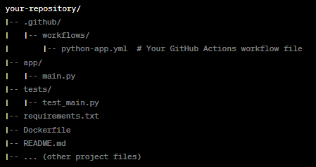
Typical GitHub Actions – Workflow structure
Notes:
This slide explains the typical workflow structure for a project using GitHub Actions. Here's a breakdown:
Structure Breakdown
.github/ Directory:
This is a special directory in a GitHub repository where workflow files for GitHub Actions are stored.
Contains a subdirectory:
workflows/: Holds the workflow .yml files that define your CI/CD pipelines.
Example File:
python-app.yml: A YAML file specifying the workflow for building, testing, or deploying a Python application.
app/ Directory:
Contains the main application code.
Example: main.py is the primary script for your Python application.
tests/ Directory:
Stores test scripts.
Example: test_main.py contains unit tests to validate the functionality of main.py.
requirements.txt:
Lists Python dependencies required by the application.
Used during the workflow to set up the environment.
Dockerfile (optional):
Defines the containerization setup for the application.
Useful for workflows involving containerized deployments.
README.md:
Documentation file for the repository.
Provides instructions and information about the project.
Other Files:
Could include configuration files, data files, or other resources necessary for the application.
How GitHub Actions Works with This Structure
The workflow file (python-app.yml) in .github/workflows is triggered based on events like:
Code pushes
Pull requests
Scheduled jobs
Typical steps in the workflow might include:
Checking out the repository code.
Setting up the required Python environment.
Installing dependencies from requirements.txt.
Running tests in the tests/ directory.
Building or deploying the application using the Dockerfile.

Slide 36
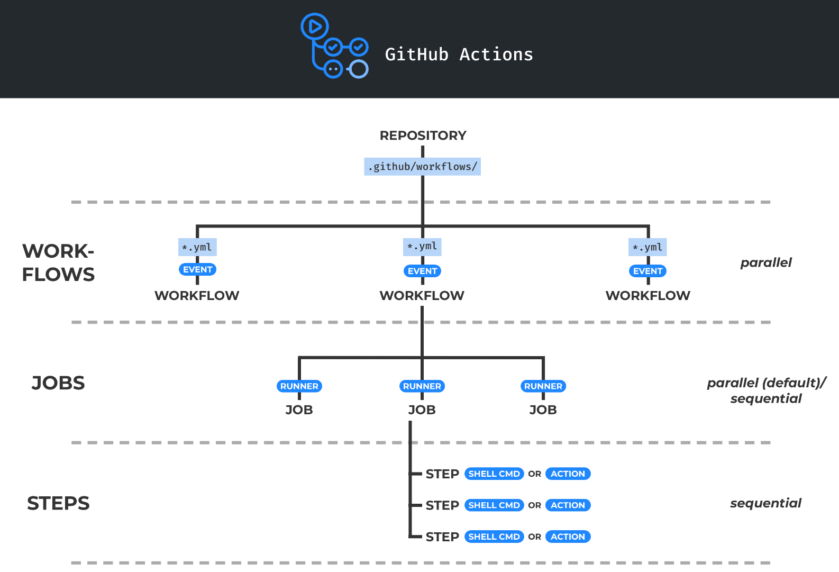
GitHub Actions
A workflow is triggered by one or more events. Event can be internal (push or PR) or external (webhook call)
A job contains a set of commands that will be run when the workflow is triggered
A runner is a virtual machine hosted by GitHub with an operating system. Each job runs inside a container
A step is either a shell command or an action
An action is a reusable unit of code which can be included as a step of a job. Actions can have inputs and outputs.
Notes:
This slide provides an overview of GitHub Actions' structure and workflow execution:
Key Components of GitHub Actions
Repository and Workflow Location:
Workflows are stored in the .github/workflows/ directory within the repository.
Each workflow is defined in a .yml file.
Triggering Events:
A workflow is triggered by specific events:
Internal Events: Such as pushes, pull requests (PRs), or merges.
External Events: Webhook calls from external systems.
Each .yml workflow file corresponds to one workflow.
Workflows:
A workflow contains multiple jobs and is triggered in response to events.
Workflows can run in parallel.
Jobs:
A job is a set of commands or actions that execute as part of the workflow.
Jobs can run in parallel by default or sequentially if dependencies between jobs are specified.
Each job runs in an isolated runner (virtual machine hosted by GitHub).
Steps:
Jobs are broken into steps that execute in sequence.
A step can:
Run a shell command.
Execute a reusable action (a predefined script or tool).
Actions:
Actions are reusable code snippets or tasks included in workflows.
Actions can:
Take inputs (e.g., parameters).
Produce outputs (e.g., logs or artifacts).
Execution Flow
Workflows are triggered → contain multiple jobs → each job runs in a runner → consists of steps (commands/actions).
Key Points
Workflows and jobs can run in parallel to improve efficiency.
Steps within a job run sequentially.
Actions make it easy to standardize and reuse tasks across workflows.

Slide 37
Thank You!

